Slide 1




Personal Information
Autonomous University of Baja California
Faculty of Chemical Sciences and Engineering
Student: Gómez, Emmanuel A.
Teacher: Reyes, Karla F.
English I

Slide 2
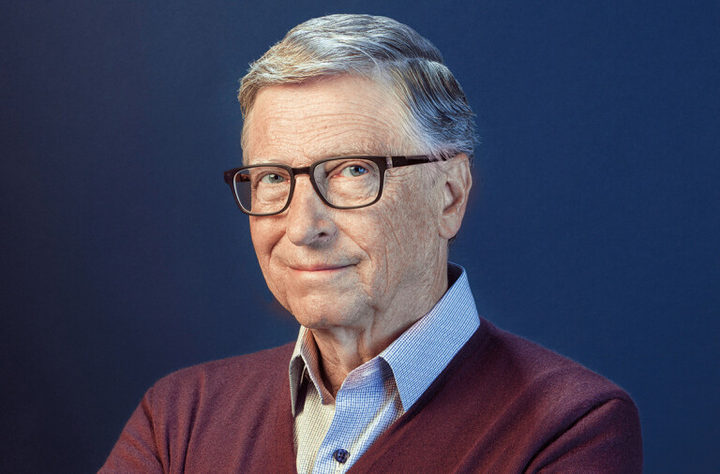
Who is he?
What is his occupation?
He’s an Entrepeneur.
He’s William (Bill) Gates.
Where is he from?
How old is he?
He’s 66 years old.
He’s from the United States.

Slide 3
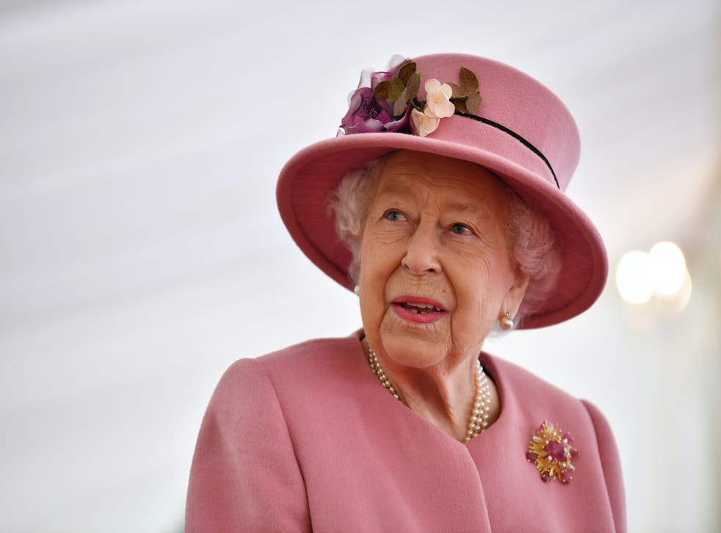
Who is she?
What is her occupation?
She’s (Queen) Elizabeth (II) Mary.
She’s a politician.
Where is she from?
How old is she?
She’s 95 years old.
She’s from the United Kingdom.

Slide 4
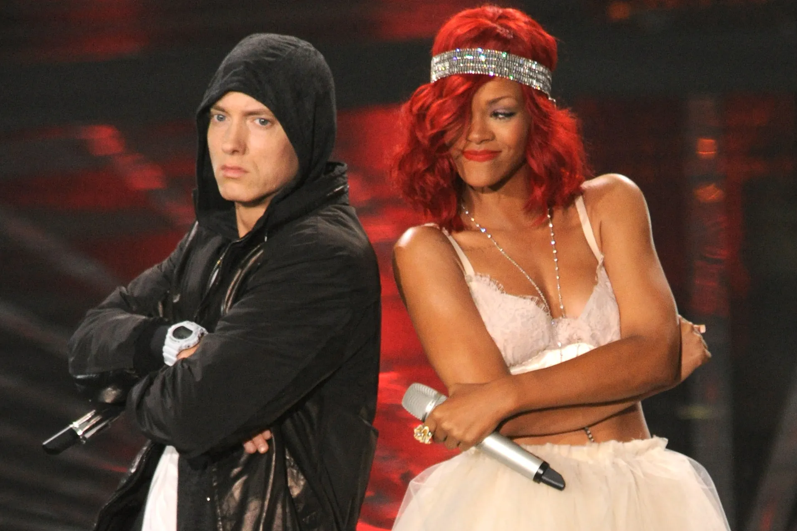
Who are they?
What is their occupation?
They’re Marshall Mathers and Rihanna.
They’re Singers.
Where are they from?
How old are they?
They’re 49 and 34 years old.
He’s from the US and she’s from Barbados .

Slide 5
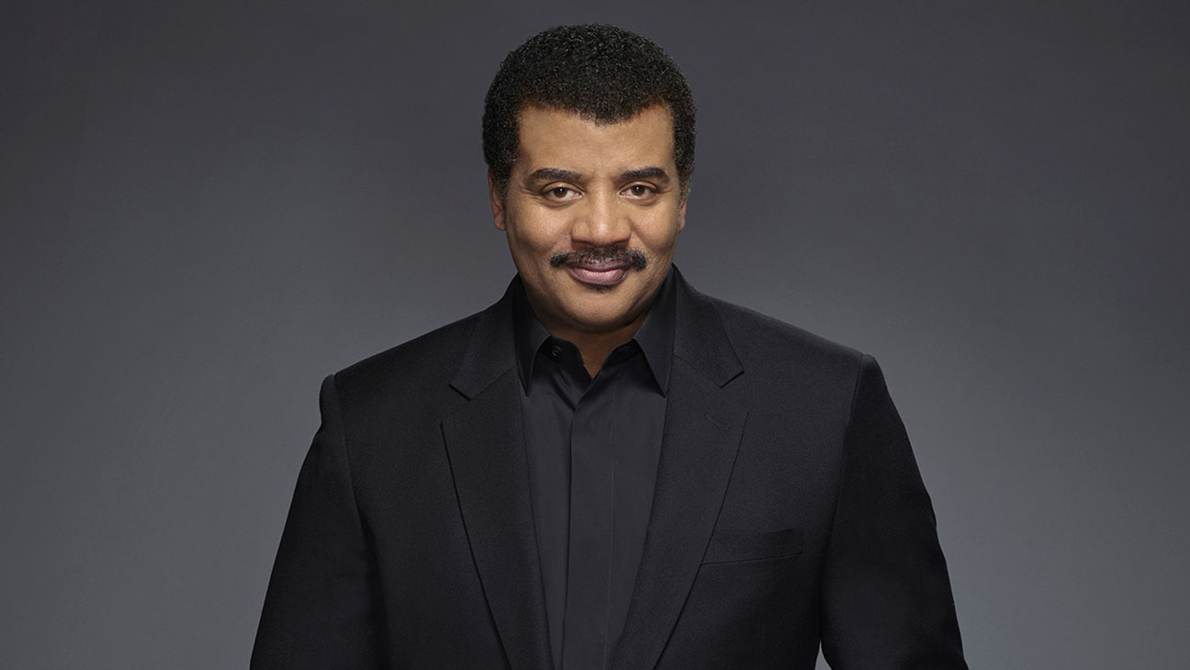
Who is he?
What is his occupation?
He’s an Astrophysicist.
He’s Neil deGrasse Tyson.
Where is he from?
How old is he?
He’s 63 years old.
He’s from the United States.

Slide 6
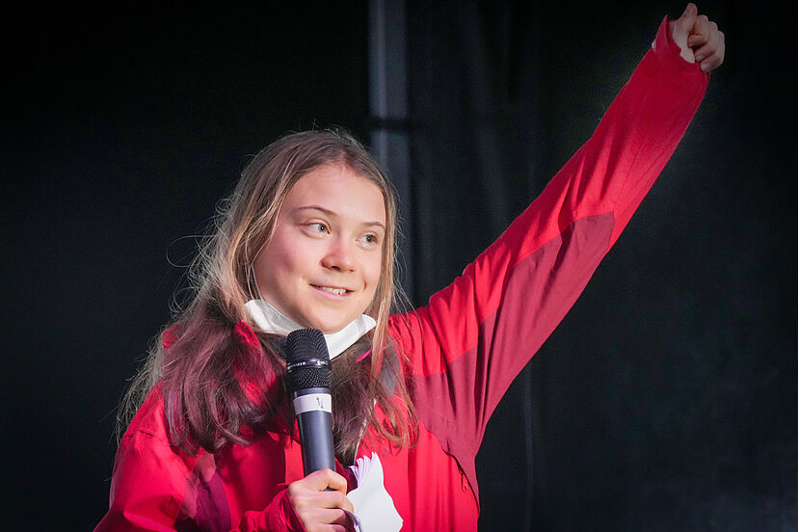
Who is she?
What is her occupation?
She’s Greta Thunberg.
She’s an activist.
Where is she from?
How old is she?
She’s 19 years old.
She’s from Sweden.

Slide 7

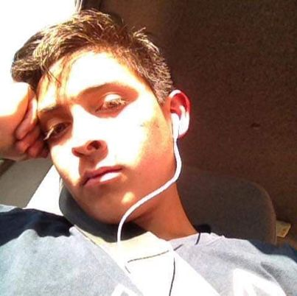
Who is he?
What is his occupation?
He’s Emmanuel Gómez.
He’s an student.
Where are they from?
How old is he?
He’s 21 years old.
He’s from México.

